Slide 1

Development of Self-Stabilizing 3-DOF -RRR Camera System using Fuzzy Logic
By
DHARMENDRA KUMAR SHARMA,
C. P. SHARMA , SURENDRA S. PATEL
B. A. BOTRE, S. A. AKBAR
CSIR-Central Electronics Engineering Research Institute, Pilani -333 031
pvlr@ceeri.ernet.in
Presented at
12th IEEE India International Conference INDICON 2015, E3-C3 17-20 December, Jamia Milia Islamia, New Delhi, India

Slide 2
Contents
Introduction:
Developed System:
  Block diagram
  Image Capturing and Processing
  Fuzzy logic Implementation
  Fuzzy logic’s Linguistic variables & Rules
Angle Tracking
Results:
Conclusions
Acknowledgements
References

Slide 3
Introduction
Development and control of the robotic system having 3-revolutionary joints, (RRR/3-R) robotic manipulator platform using orthogonal servo motors, and image based object tracking and camera stabilizing scheme controlled with fuzzy logic to neutralize the movement of object.
For yaw and pitch angle tracking IMU unit is mounted on camera to monitoring servo motor angles, that indicates the validity and precision of applied control logic.

Slide 4
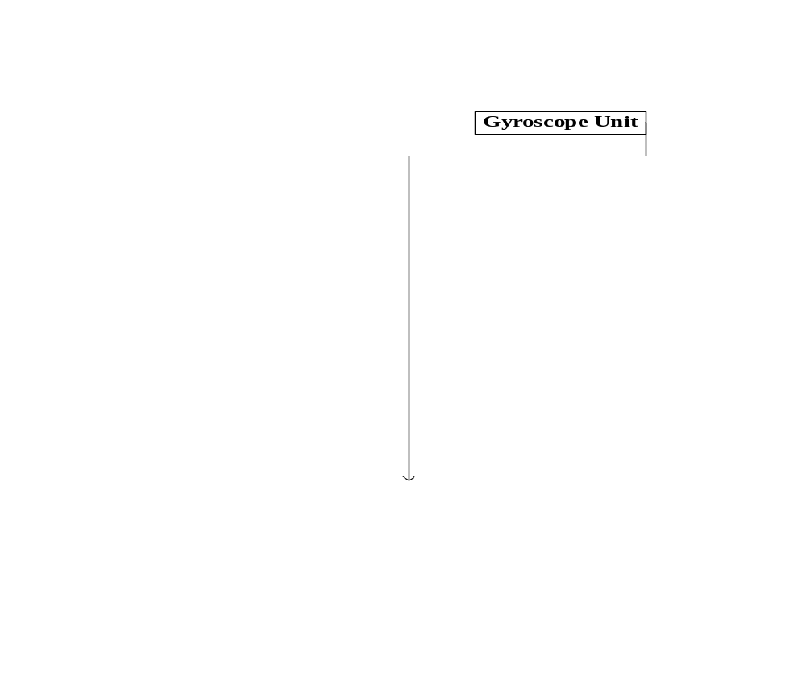
Developed System

Slide 5
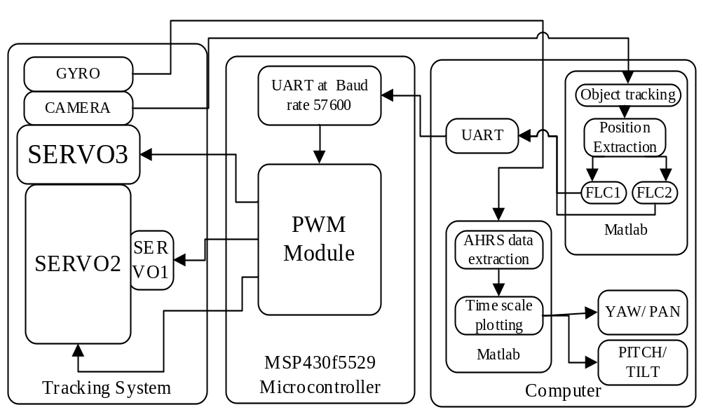
BLOCK DIAGRAM OF SYSTEM WORKING

Slide 6
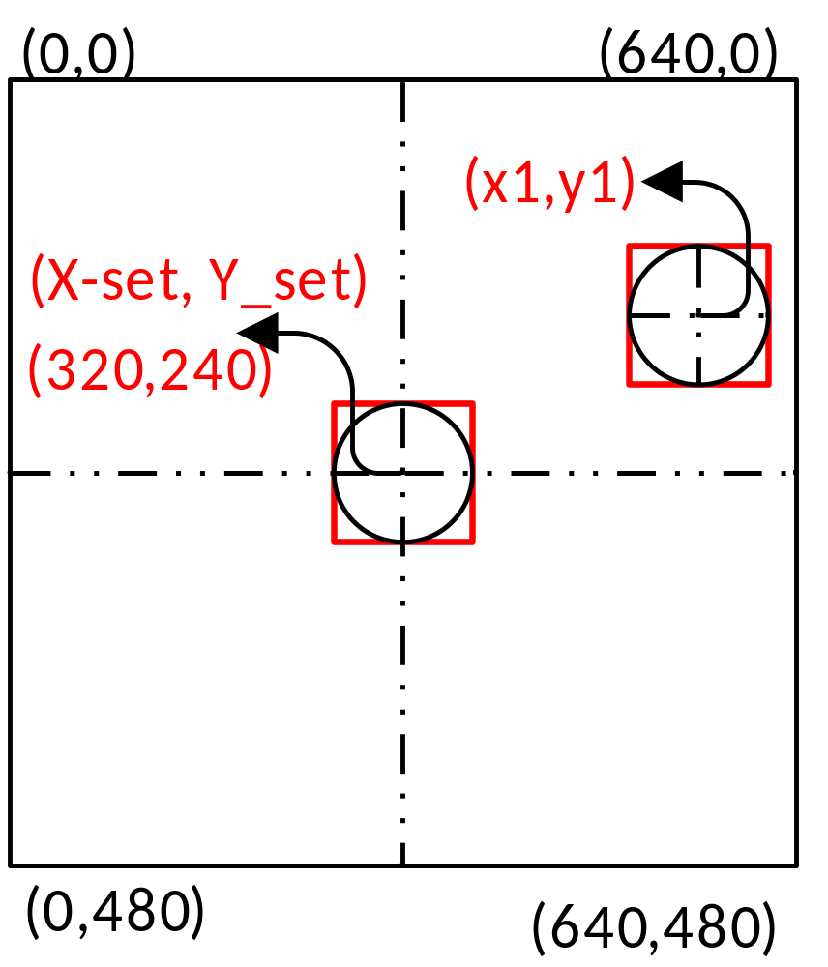
Image Capturing and Processing
Image Frame : 640x480
Stable State: (X_set,Y_set) = (320,240)

Slide 7
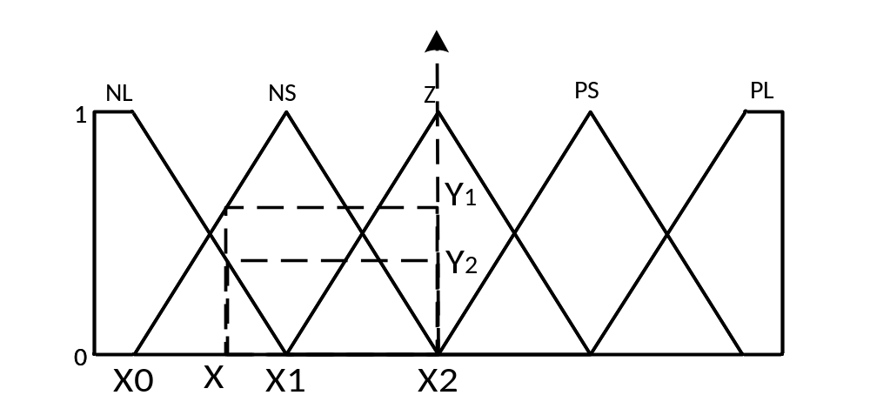
Fuzzy logic Implementation
Geometrically, solving for membership functions-
If (X: X0 < X < X1) THEN Y1 (or Y_{NL}) = ( X - X0 ) / ( X1 – X0) and
If (X: X1 < X < X2) THEN Y2 (or Y_{NS}) = ( X2 - X ) / ( X2 – X1).

Slide 8
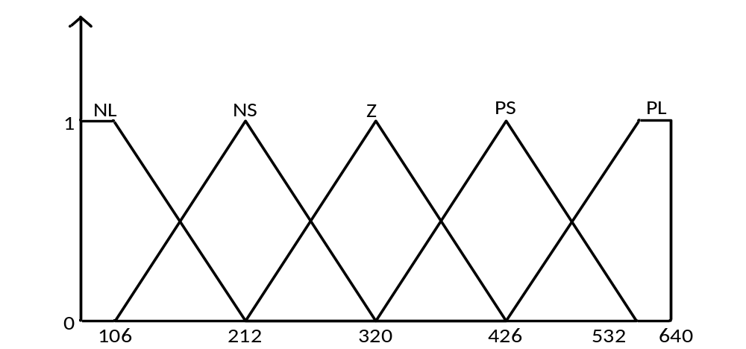
Input linguistic variable
Pixel position is the only input variable for fuzzy logic system to control the motor.
The fuzzyfication rules for the control of motor servo3, having X pixel as the input variable. (see Fig.)
Input Variable Ranges
negative large (NL),
negative small (NS),
Zero (Z),
positive small (PS) and
positive large (PL)

Slide 9

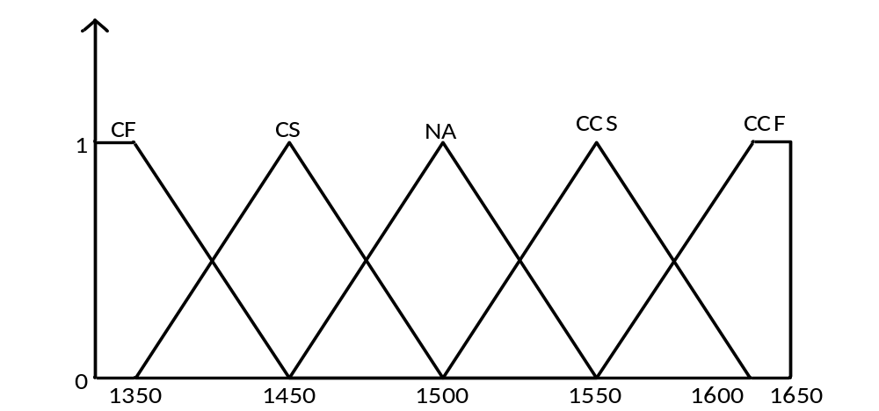
Output linguistic variable
Servo duty cycle value is the only output variable for fuzzy logic system to control the motor.
Output Variable Ranges
CF (clockwise fast),
CS (clockwise slow),
NA (no motion),
CCS (counter clockwise small),
CCF (counter clockwise fast).

Slide 10
Defuzzyfication Rules
Input Linguistic
Output Variable
negative large (NL),
negative small (NS),
Zero (Z),
positive small (PS) and
positive large (PL)
CF (clockwise fast),
CS (clockwise slow),
NA (no motion),
CCS (counter clockwise small),
CCF (counter clockwise fast).

Slide 11
Angle Tracking
In order to track the pitch and tilt angle adjustment by the both servo motors, an AHRS based 9 DOF gyroscope is attached over the camera.
The IMU is directly interfaced with the MATLAB using serial communication with the help of a USB to serial converter.
The fetching of AHRS data and extraction of Yaw, Roll and Pitch is done in MATLAB using mathematical computation based on the format of the AHRS data.
To monitor the Yaw (pan) and Pitch (tilt), angle vs time scale plot has been plotted. The real time duration for the time scale is calculated using the “tic-toc” function.

Slide 12
Results
Two Fuzzy logic controller, one for each servo with one input, one output, five linguistic variables, and five rules has been successfully implemented.
Initial zig- zag in each plot is not the deviation of camera, but it is introduced manually by software to display the full range of the angles that gyro provides.

Slide 13
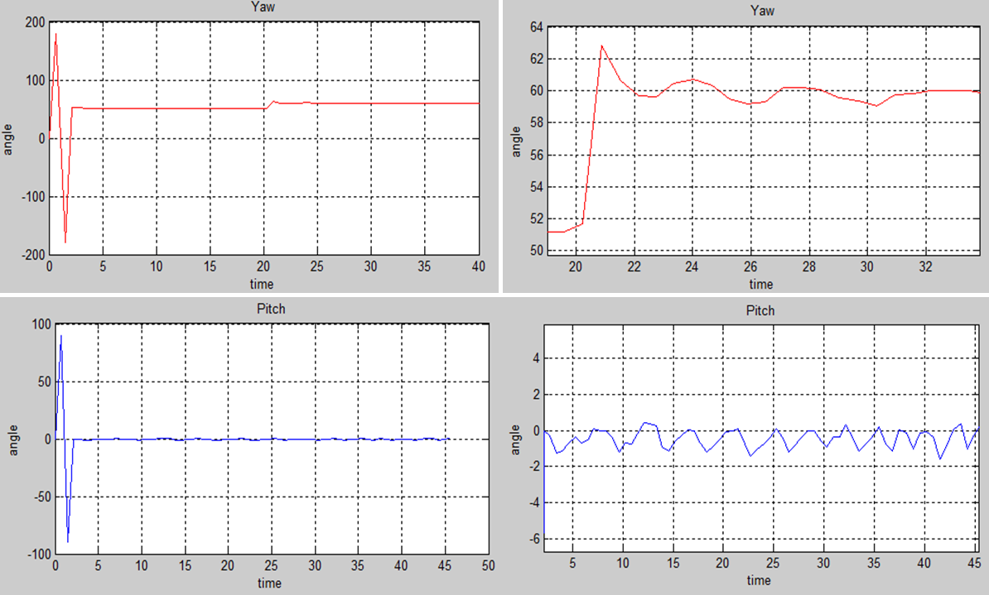
Continue…
Yaw angle tracking when the object is initially situated at the left most of the image frame, having input linguistic variable 0 (X pixel), also displaying the variation in pitch (tilt of camera) when system traverse to track the object.

Slide 14
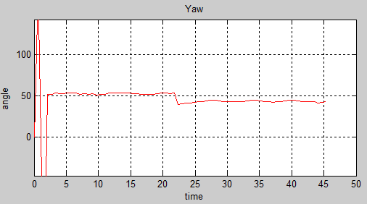
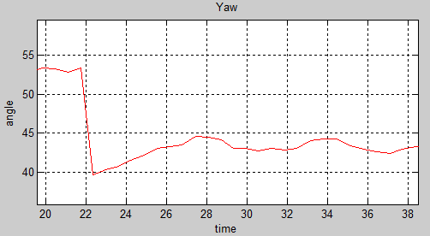
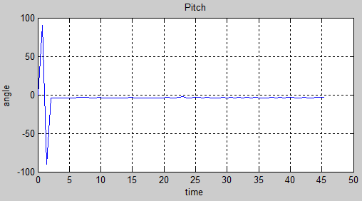
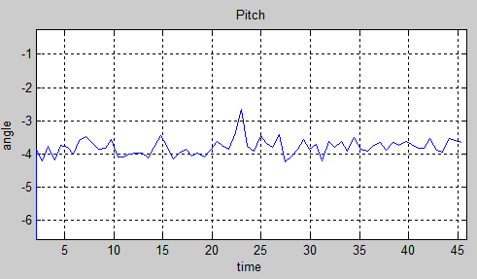
Continue…
Yaw angle tracking when the object is initially situated at the right most of the image frame, having input linguistic variable 640 (X pixel), also displaying the variation in pitch when system traverse to track the object.

Slide 15
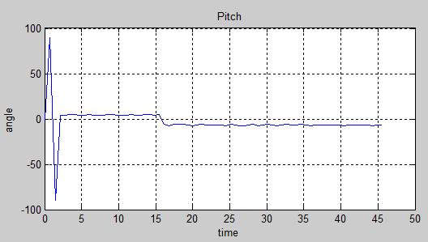
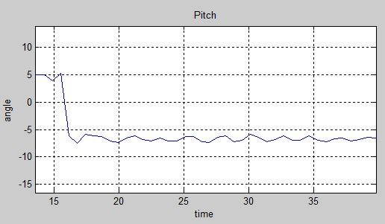
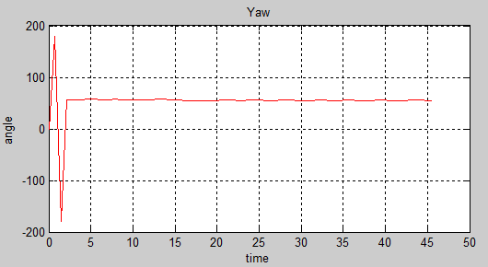
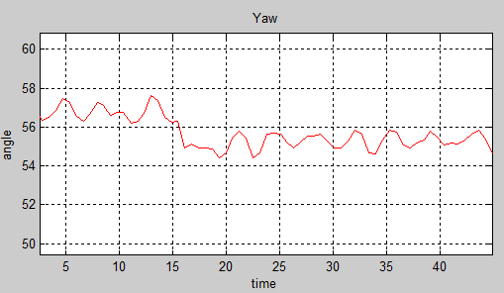
Continue…
Pitch angle tracking when the object is initially situated at the top most of the image frame, having input linguistic variable 0 (Y pixel), also displaying the variation in Yaw angle when system traverse to bring at mid of the frame.

Slide 16
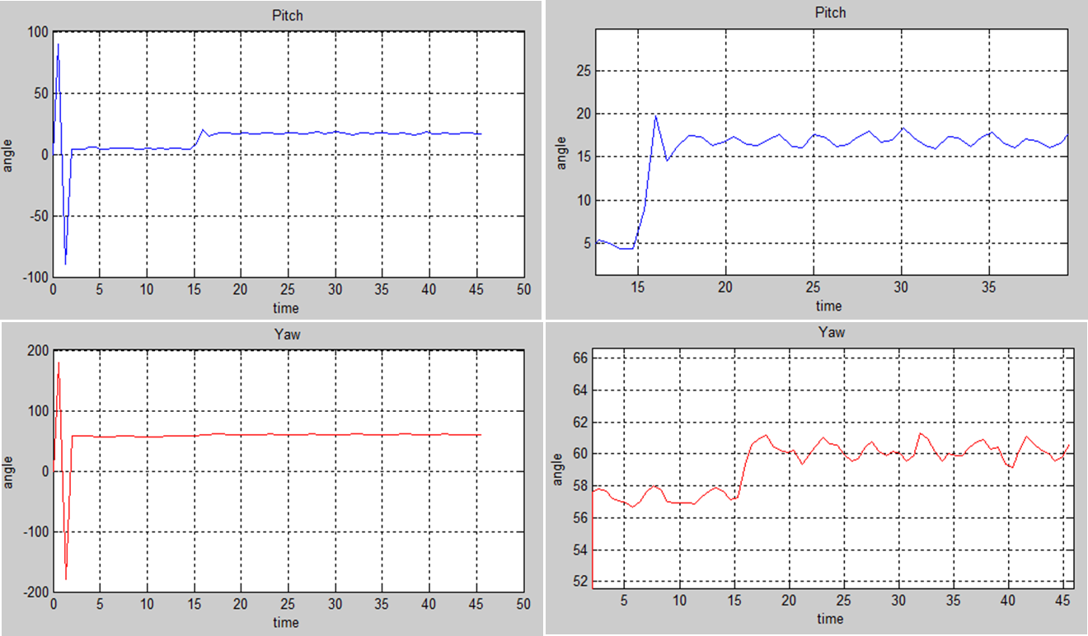
Continue…
Pitch angle tracking when the object is initially situated at the bottom most of the image frame, having input linguistic variable 480 (Y pixel), also displaying the variation in Yaw angle when system traverse to bring at mid of the frame.

Slide 17
Continue
Average Angular fluctuation in Yaw (pan)angle:1.6 degree
Average Angular fluctuation in Pitch angle: 2.5 degree
Maximum tracking time when object is at extreme of image frame: 600ms

Slide 18
Conclusion
An un-modeled 3-DOF camera stabilizing platform system with an idea of fuzzy logic control algorithm implementation.
The fluctuation in pitch angle tracking is more because of there is a lot load on the motor servo1. This problem could be eliminated by using high torque metal gear motor.
When multiple objects of same features come in front of camera and both got detected then system will get confused that which is true object to be tracked. We can overcome this problem by making system smart in terms of image processing and object tracking.

Slide 19
ACKNOWLEDGEMENT
The work presented in this paper is done in Electronic Control system Lab at CSIR-Central Electronic Engineering Research Institute. The authors extend their gratitude to the director CSIR-CEERI, for providing healthy atmosphere of work. Also, we would like to thank the working members of our lab for their constant support.

Slide 20
REFERENCES
[1] J. Nygards, P. Skoglar, M. Ulvklo, T. Hogstrom, "Navigation aided image processing in uav surveillance: Preliminary results and design of an airbone experimental system"," Journal of Robotic systems, vol. 21, no. 2, pp. 63-72, 2004.
[2] R. Antonello, R. Oboe, A. Ramello, K. Ito, N. Felicini, "IMU- aided image stabilization and tracking in a HSM-driven camera positioning unit".
[3] Munadi, M. A. Akbar, "Simulation of Fuzzy Logic Control for DC Servo Motor using Arduino based on Matlab/ Simulink," in International Conference on Intelligent Autonomous Agents, Networks and Ststems, Bandung, 2014.
[4] H. Yu, "DSP-BASED Fuzzy Logic Servo Motor Control," Conference on Control Engineering and Communication Technology, pp. 556-559, 2012.
[5] R. Kumar, H. Sawhney, S. Samarasekera, S. Hsu, H. Tao, Y Guo, K. Hanna, A. Pope, R. Wildes, D. Hirvonen, M. Hansen, P.Burt, "Arial video surveillance and exploitation," Proc. IEEE, vol. 89, no. 10, pp. 1518-1539, 2001.

Slide 21
Thankyou

Slide 22
Queries

